Slide 1
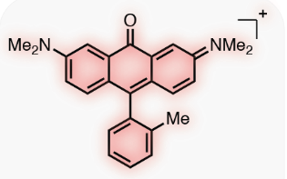
Curation
“clean” data
Splitting
Training/Validation/Test
Featurization
Model Training
Prediction
Bunch of
numbers
Learn to store & read in models
Use to predict on novel molecules
GMD…
Remove NaN values
Average
duplicates
Remove outliers
(subjective)
• Scaffold
• Butina
• Fingerprint
• Index
• Random
• Ave_min
• Stratified
• Temporal
ecfp •
graphconv •
(?) molvae •
descriptors •
computed_descriptors •
• Random Forest (RF)
• Neural Network (NN)
• XGBoost
mordred_filtered ◄
rdkit_raw ◄
moe ◄
Recommended
mordred_raw ◄
moe_raw ◄
moe_norm ◄
moe_filtered ◄
moe_scaled ◄
moe_scaled_filtered ◄
moe_informative ◄
This has been accomplished.
More

Slide 2
Prediction
Tutorial 10:
Trained & stored models
• Random Forest
• Neural Network
• XGBoost
* In separate runs, loaded models and used for property predictions of molecules in data file.
* After much checking by hand, discovered that returned dataframes containing property
predictions have first-column indices jumbled up.
* printing of "predict_results" returned from pfm.predict_from_model_file(...)
[1117 rows x 3 columns]
compound_id standardized_smiles VALUE_NUM_mean_pred
650 Amigdalin N#CC(OC1OC(COC2OC(CO)C(O)C(O)C2O)C(O)C(O)C1O)c1ccccc1 -1.290342
830 Fenfuram Cc1occc1C(=O)Nc1ccccc1 -2.861390
1101 citral CC(C)=CCCC(C)=CC=O -2.116892
1062 Picene c1ccc2c(c1)ccc1c2ccc2c3ccccc3ccc21 -8.110549
... ... ... ...
753 Isobutyl acetate CC(=O)OCC(C)C -1.195849
781 2,2,3-Trimethylbutane CC(C)C(C)(C)C -4.314862
201 2,3,3',4,4'6-PCB Clc1ccc(-c2c(Cl)cc(Cl)c(Cl)c2Cl)c(Cl)c1Cl -7.704184
5 Stirofos COP(=O)(OC)OC(=CCl)c1cc(Cl)c(Cl)cc1Cl -4.551396
Learn to store & read in models
Use to predict on novel molecules
GMD…
• Can cause merged/created dataframes using predicted dataframe to become randomized.
• Should reset indices (reset_index(drop=True)) or use another column to merge on – compound_id, etc.
• Amanda said they thought they fixed this issue, will fix it for next release.

Slide 3
Prediction
Tutorial 10:
Trained & stored models – Further analysis of predicted vs. actual data
shows XGBoost overfits on training set
• Random Forest
• Neural Network
• XGBoost
Learn to store & read in models
Use to predict on novel molecules
GMD…
Random Forest
Neural Network
XGBoost
• Train: R² = 0.9892
• Valid: R² = 0.6682
• Test: R² = 0.7759
• Train: R² = 0.9494
• Valid: R² = 0.7926
• Test: R² = 0.8369
• Train: R² = 0.9995
• Valid: R² = 0.7587
• Test: R² = 0.7723
Actual
Predicted
Predicted
Predicted

Slide 4
Prediction
Learn to store & read in models
Use to predict on novel molecules
GMD…
Next Task

Slide 5
Generative Molecular Design
1. Design new molecules (need to learn, very next step after below)
2. Useful, or requirement, to interconvert between the various molecular structure formats
Installed/using Open Babel for this step
GMD
Open Babel
GAMESS.log
or
other (x,y,z) file like .pdb
.mol
format
SMILES
string
.mol (3D)
GAMESS.inp
or other (x,y,z)
format for “filtering/refinement”
RDKit
SMILES → 3D (.mol) is a non-trivial, very tricky, problem!
1) Converting SMILES to anything 3D is incredibly challenging.
2) Even if 1) can be done okay, molecules can have many isomers/conformers.
Creating appropriate/best structures formidable – even approximate ones.
3) Stage 1 – try to make a reasonable structure, refinement later.
Stage 2: Filtering/refinement
More elaborate method to improve molecular geometry and identify best conformations.
Thinking DFT-B + solvent with GAMESS.

Slide 6
Done
Done
Installed/using Open Babel for this step
GMD
Open Babel
GAMESS.log
or
other (x,y,z) file like .pdb
.mol
format
SMILES
string
.mol (3D)
GAMESS.inp
or other (x,y,z)
format for “filtering/refinement”
RDKit
In progress
1. Designed diverse, challenging 8-molecule test set.
2. Researching & testing advanced SMILES → 3D (mol) conversion methods in RDKit.

Slide 7
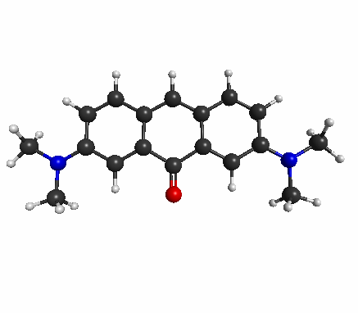
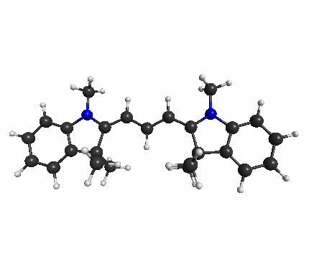
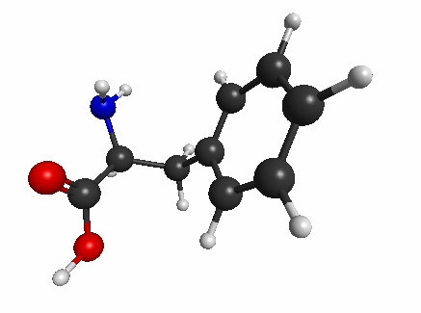
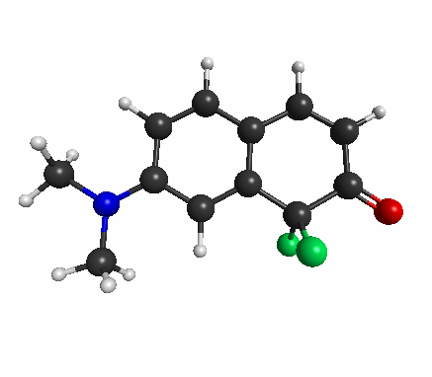
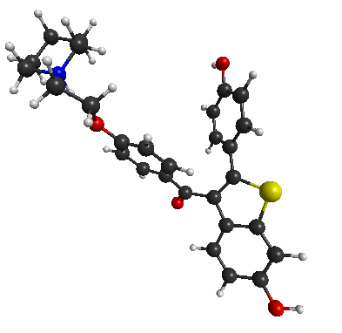
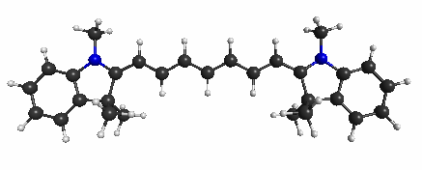
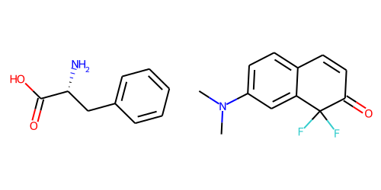
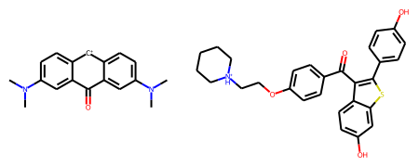
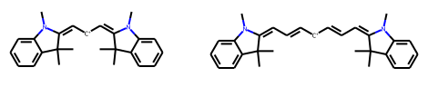
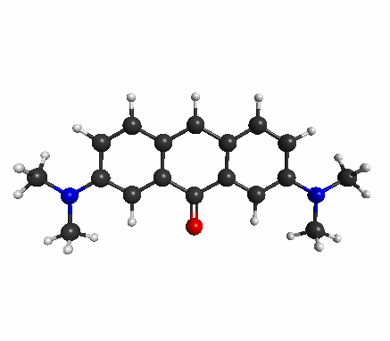
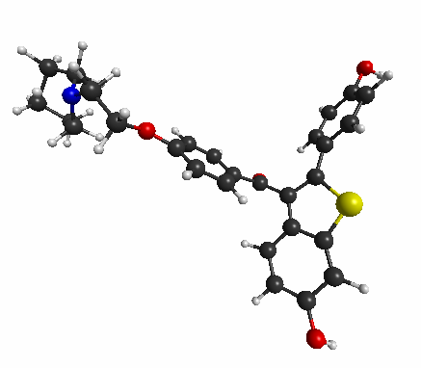
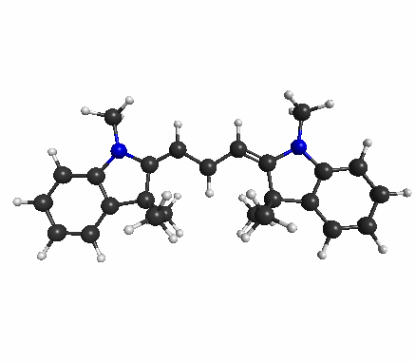
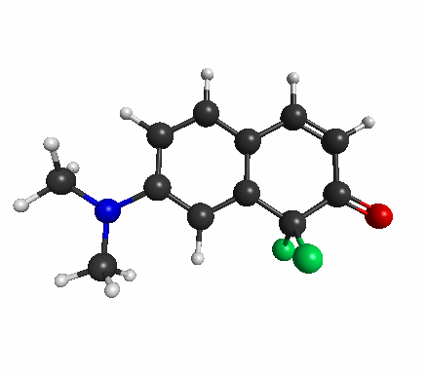
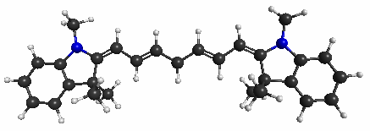
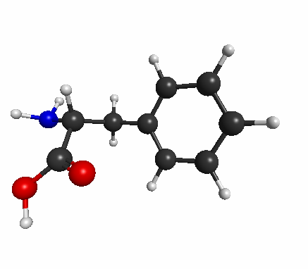
6 molecule test set
Designed from Quantum, built by NCI
GAMESS.log
B3LYP Opt Geoms
Phenylalinine
Fluorocoumarin
Keto-pyronin
Raloxifene
Cy3
Cy7
.mol
Manually set N(+1)
RDKit cannot handle
4-coord N if not +1.
SMILES
N[C@H](Cc1ccccc1)C(=O)O
CN(C)c1ccc2c(c1)C(F)(F)C(=O)C=C2
CN(C)c1ccc2c(c1)C(=O)c1cc(N(C)C)ccc1[CH+]2
O=C(c1ccc(OCC[NH+]2CCCCC2)cc1)c1c(-c2ccc(O)cc2)sc2cc(O)ccc12
CN1/C(=C/[CH+]/C=C2/N(C)c3ccccc3C2(C)C)C(C)(C)c2ccccc21
CN1/C(=C/C=C/[CH+]/C=C/C=C2/N(C)c3ccccc3C2(C)C)C(C)(C)c2ccccc21
RDKit depiction
.mol (3D)
GAMESS.inp
Incredibly, every molecule has been recreated almost exactly

Slide 8
6 molecule test set
Designed from Quantum, built by NCI
Actual python3 code:
mol = Chem.MolFromMolFile(file)
mol_smile = Chem.MolToSmiles(mol)
mol = Chem.MolFromSmiles(i)
mol_H = Chem.AddHs(mol)
ps = AllChem.ETKDGv3()
ps.useSmallRingTorsions=True
ps.maxIterations = 500
ps.useRandomCoords=False
ps.randomSeed=13 (for reprodicibility)
AllChem.EmbedMultipleConfs(mol_H,numConfs=1, params=ps)
Chem.MolToMolFile(mol_H, file)
Open Babel for .mol → GAMESS.inp conversion
GAMESS.log
B3LYP Opt Geoms
Phenylalinine
Fluorocoumarin
Keto-pyronin
Raloxifene
Cy3
Cy7
Read molecule from .mol file
Convert to SMILES
.mol
Manually set N(+1)
RDKit cannot handle
4-coord N if not +1.
Rough conversion SMILES => .mol (3D)
SMILES
N[C@H](Cc1ccccc1)C(=O)O
CN(C)c1ccc2c(c1)C(F)(F)C(=O)C=C2
CN(C)c1ccc2c(c1)C(=O)c1cc(N(C)C)ccc1[CH+]2
O=C(c1ccc(OCC[NH+]2CCCCC2)cc1)c1c(-c2ccc(O)cc2)sc2cc(O)ccc12
CN1/C(=C/[CH+]/C=C2/N(C)c3ccccc3C2(C)C)C(C)(C)c2ccccc21
CN1/C(=C/C=C/[CH+]/C=C/C=C2/N(C)c3ccccc3C2(C)C)C(C)(C)c2ccccc21
3D structure refinement
Many iterations of all options/methods to finalize this
RDKit depiction
.mol (3D)
Output in .mol format
GAMESS.inp
Incredibly, every molecule has been recreated almost exactly

Slide 9
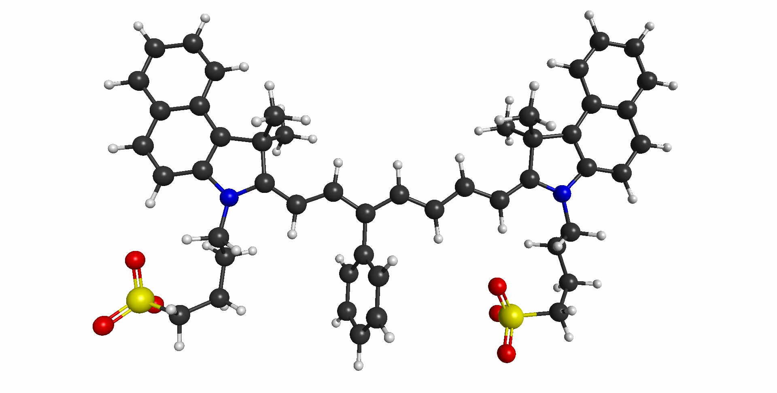
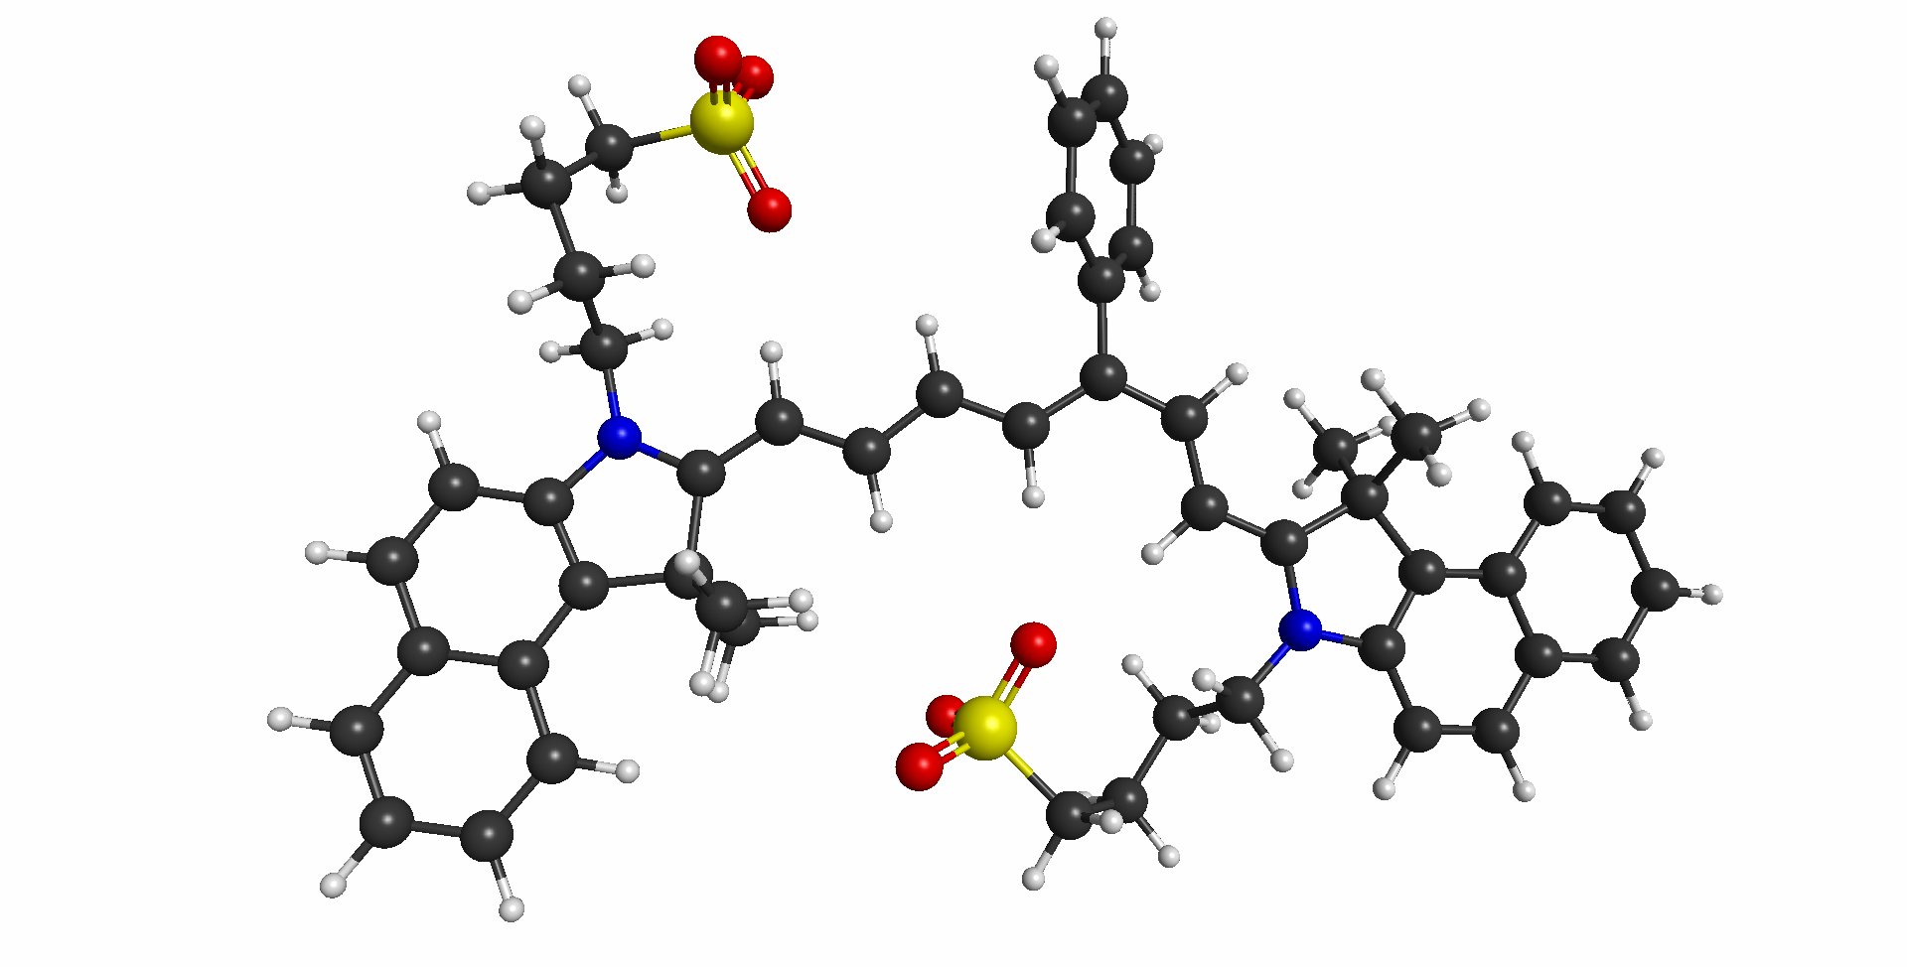
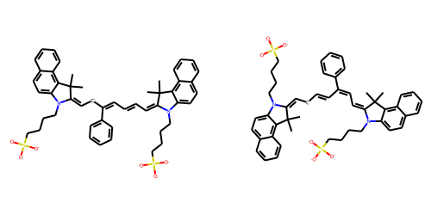
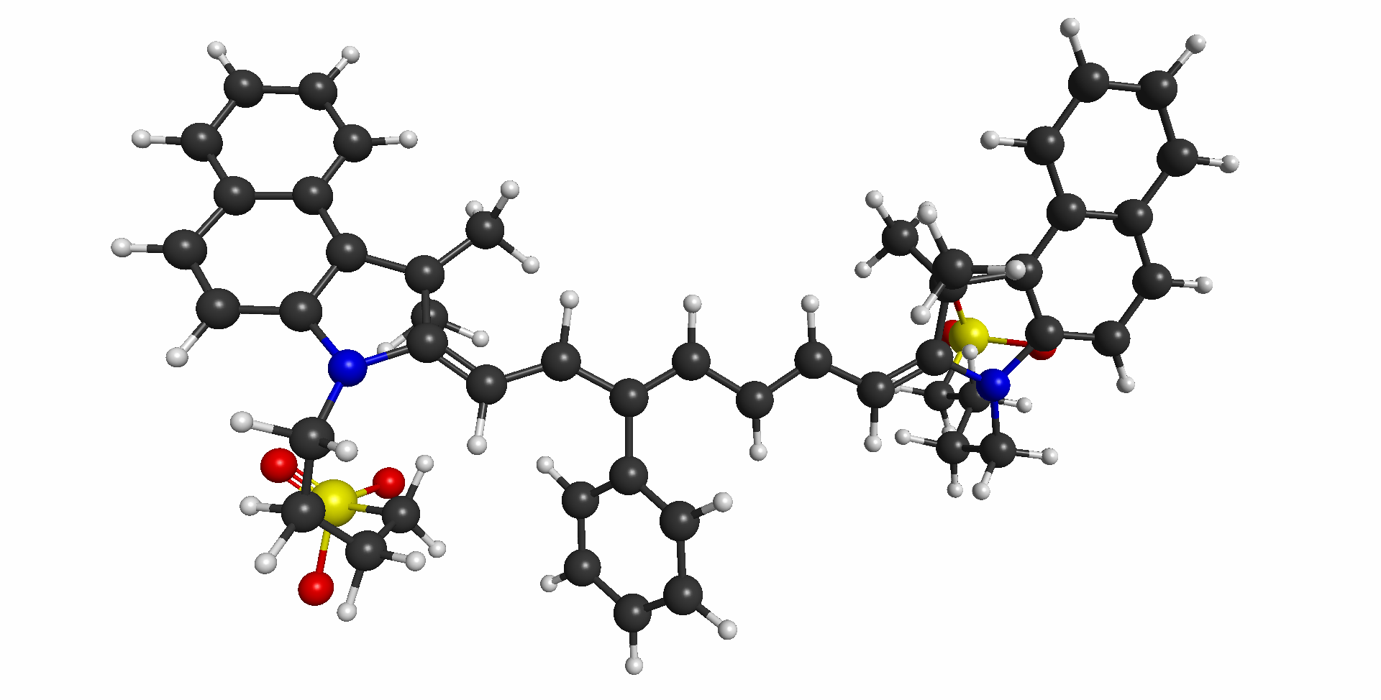
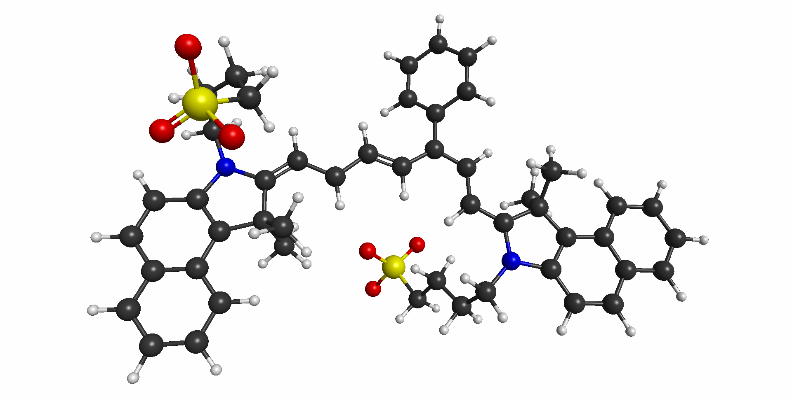
Extremely Difficult Challenge!
ICG-3Ph: Molecule generating mystery peaks in absorbance/emission spectra
“Regular” structure
“3-flipped isomer”: lower in energy => ~50 nm red-shift
GAMESS.log
M11 Opt Geoms
Phenyl ring available
for pi-stacking/aggregation
.mol
SMILES
CC1(C)/C(=C\C=C\C=C(\[CH-]/C=C2/N(CCCCS([O])([O])[O-])c3ccc4ccccc4c3C2(C)C)c2ccccc2)N(CCCCS([O])([O])[O])c2ccc3ccccc3c21
CC1(C)/C(=C\[CH-]/C=C/C(=C\C=C2\N(CCCCS([O])([O])[O-])c3ccc4ccccc4c3C2(C)C)c2ccccc2)N(CCCCS([O])([O])[O])c2ccc3ccccc3c21
RDKit depiction
.mol (3D)
GAMESS.inp
Pretty good recreation of original structures, but not perfect – needs refinement

Slide 10
Prediction
Learn to store & read in models
Use to predict on novel molecules
GMD…
Next Task: Start learning how to do actual GMD.
Read Kevin paper(s), learn modules used.

